Slide 1


COMP7310 Artificial intelligence of things
Tutorial 0 & 1: Signal Basis
Xinzhe Zheng
zhengxz@connect.hku.hk
Department of Computer Science
Notes:
Self-introduction
This tutorial includes two parts, rules of the following four succession labs and a brief tutorial for Lab 1, signal basis.

Slide 2
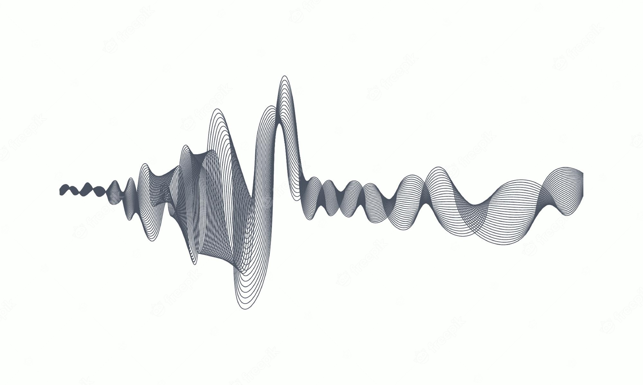
0. Introduction

Slide 3
1. Code of Points
1. Professor has pointed out in Moodle that the experimental part is 25 points in total. We have 5 labs altogether, so each lab will be 5 points.
2. It should be noted that the first part of the tutorial in each lab may have some small tasks that you need to complete, which are reflected in the signs such as "YOUR CODE HERE", "END OF YOUR CODE".
3. For the tasks in the second part, we will comprehensively give marks to students according to their performance and rank in the class.
4. Specific grading details will be given in each lab.
Notes:
You must be eager to know how you can get higher grades in these four labs.

Slide 4

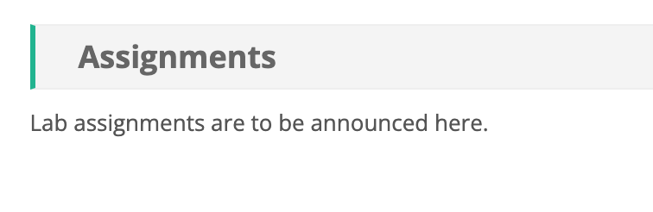
2. Work Flow
1) How to download labs?
2) How to submit labs?
You can find labs in the Assignments when it is ready.
After you finish the tasks, please compress all the files (including the generated file in the task) in to one zip file.
You have to name the zip file based on following rule: name_ID_lab#.zip.
For example, if your name is Clark, your student ID is 12345, and its our first lab, so the file name should be: Clark_12345_lab1.zip.

Slide 5
1. Signal Basis
1.1 What is a signal
1.2 Frequency domain
1.3 Special Signal
1.4 Tasks

Slide 6
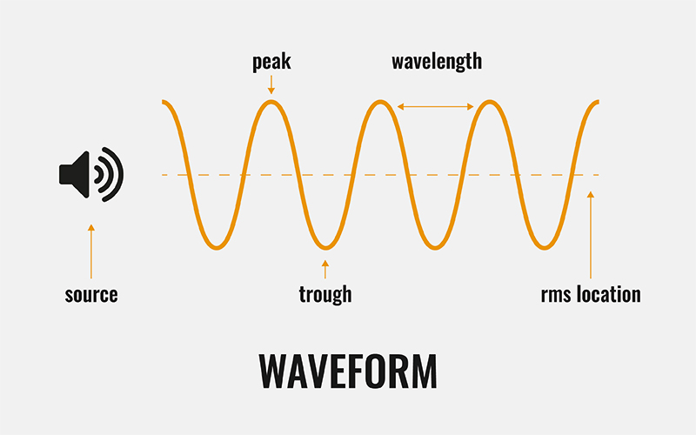
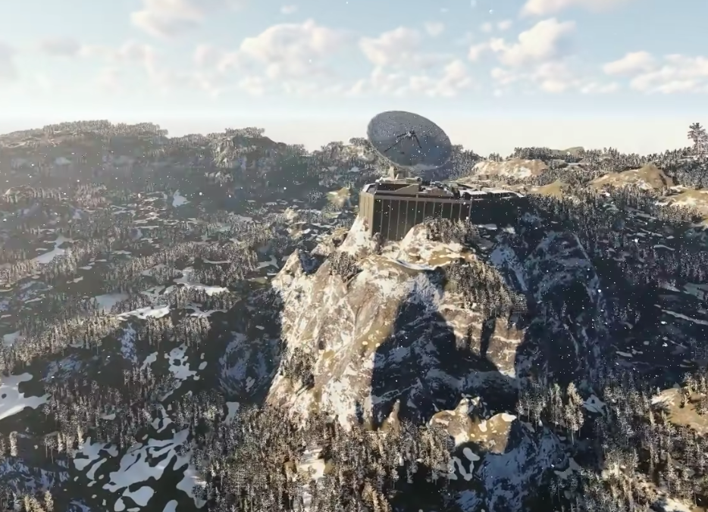
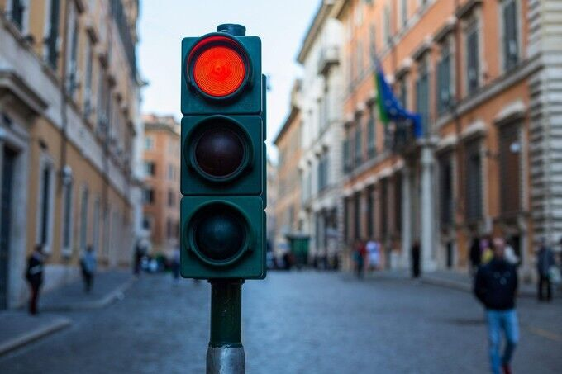
1. Signal Basis
1.1 What is a signal
Sound Wave
Electromagnetic Wave
Traffic Light
The IEEE Transactions on Signal Processing includes audio, video, speech, image, sonar, and radar as examples of signal.

Slide 7

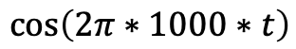
1. Signal Basis
1.1 What is a signal
How does the music sound?
Very simple sound wave
Time length: 0.02s
Frequency: 1000 Hz
Period: 0.001s
$$\cos\left(2π∗1000∗t\right)$$

Slide 8
1. Signal Basis
1.1 What is a signal
Frequency: 500 Hz
Frequency: 1000 Hz
Frequency: 2000 Hz
How to better describe this characteristic?
Sharper

Slide 9
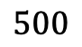
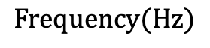

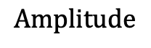
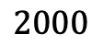
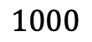
1. Signal Basis
1.2 Frequency Domain
Frequency: 500 Hz
$$Amplitude$$
By transferring the signal into frequency domain, you can know how many frequency components the signal has, which can reveal some special property.
Frequency: 1000 Hz
$$0$$
$$500$$
$$1000$$
$$2000$$
$$Frequency(Hz)$$
Frequency: 2000 Hz
Frequency: 500, 1000, 2000 Hz

Slide 10
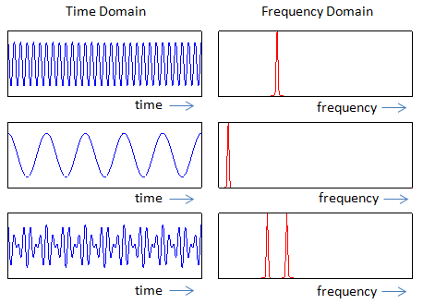
1. Signal Basis
1.2 Frequency Domain
Method
Fourier Transform

Slide 11
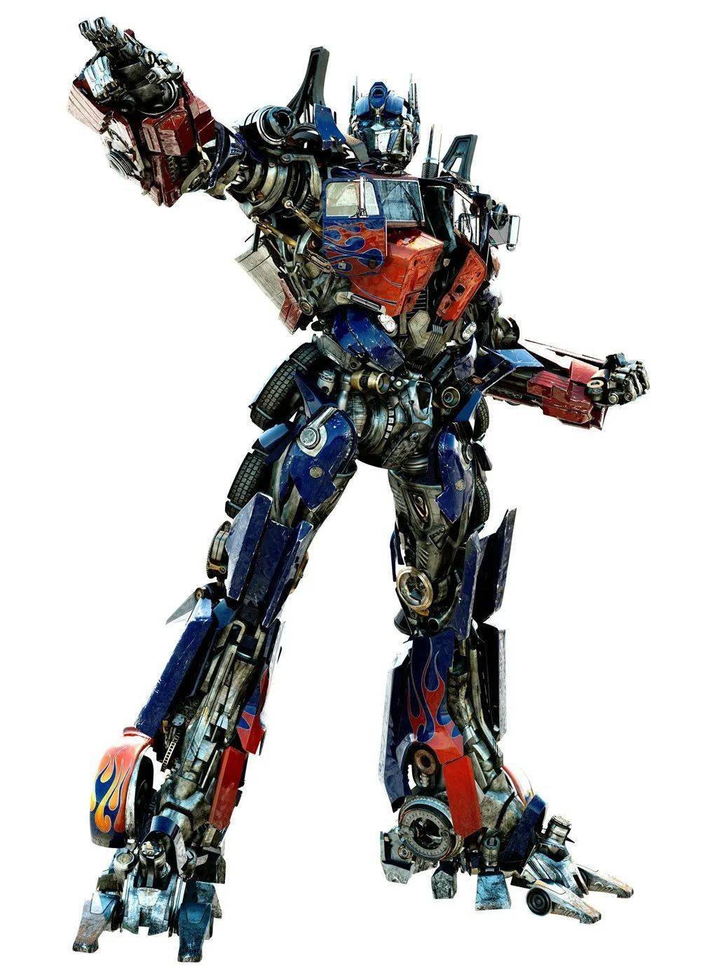
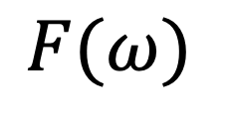
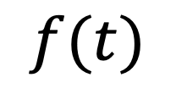
1. Signal Basis
1.2 Frequency Domain
Fourier Transform
What is Fourier?
What is Transform?
It’s just a name😂!
It’s a mapping between domains!
$$f(t)$$
$$F(ω)$$
Time Domain
Frequency Domain
The Fourier transform is reciprocal and unique （one-to-one mapping）

Slide 12
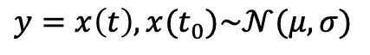
1. Signal Basis
1.3 Special Signal
Noise Signal
Almost nobody like noises, which bring unwanted information, and sometimes make data worse.
!An Exception!
The journal Frontiers in Neurology notes that white noise can also be a sleep aid in people with Insomnia
So if your data is polluted by noises, you may need to use Filters to reduce the noise.
$$y=x\left(t\right), x(t_{0})\sim 𝒩(μ,σ)$$
Gaussian Noise

Slide 13
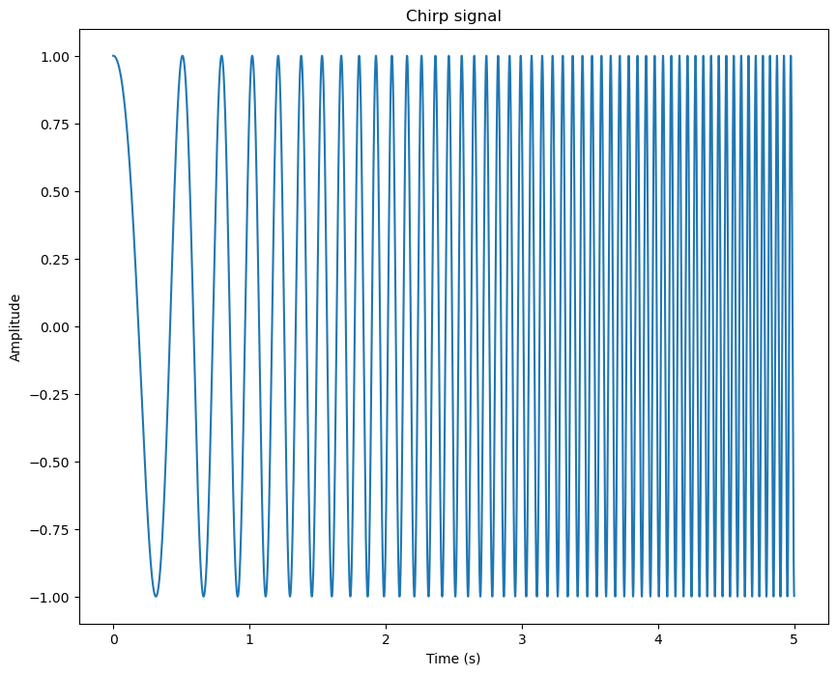
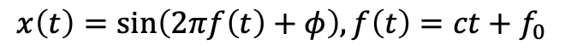
1. Signal Basis
1.3 Special Signal
Chirp Signal
Short Time Fourier Transform (STFT)
$$x\left(t\right)=\sin\left(2πf\left(t\right)+φ\right), f\left(t\right)=ct+f_{0}$$
The Frequency Domain calculated by Fourier Transform cannot show the frequency change in time domain.
Its frequency will linearly change with time.

Slide 14

1. Signal Basis
1.4 Music Flat
In Lab 1, you are asked to restore a piece of music which is six notes higher than the original one.
蒲公英的約定 Dandelion's Promise
Pitch Shift
Rising Music
Original Music

Slide 15
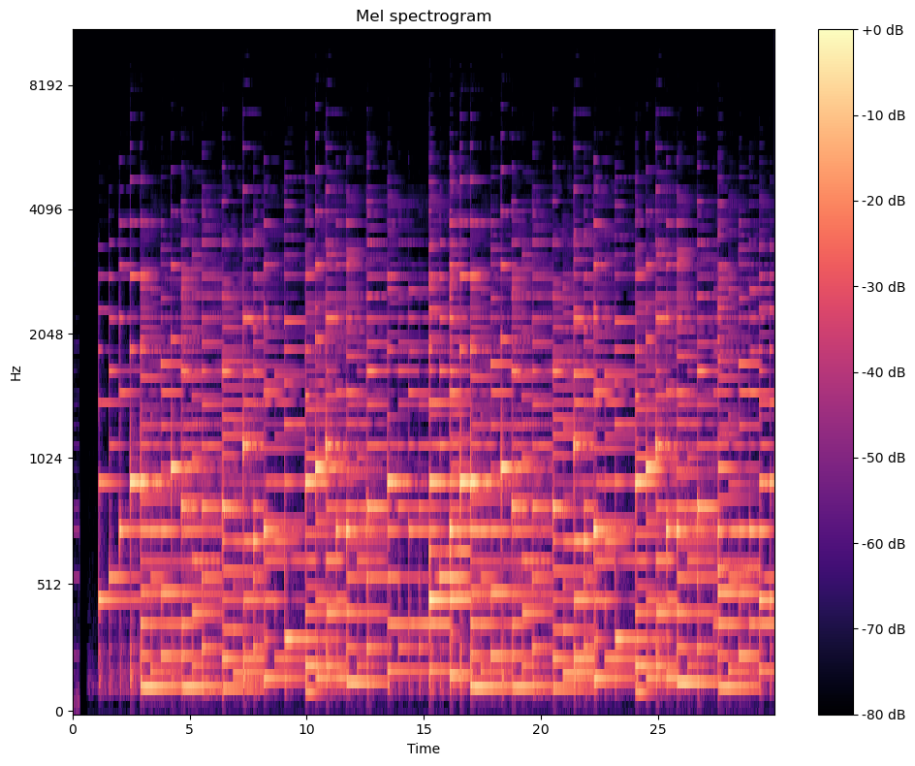
1. Signal Basis
1.4 Music Flat
Frequency Components at each time window.
You need to shift the frequency components at each time window.
You may use STFT in this lab.

